Slide 1
Marcus Movie Analysis
-Analysing Genre and Gross Income
-Budget and Gross Income

Slide 2
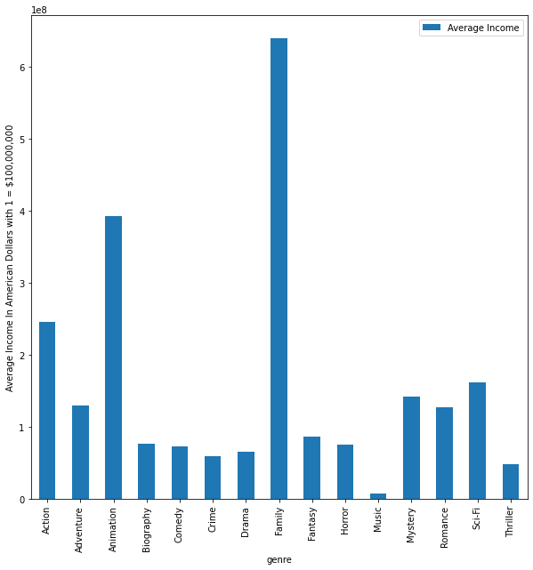
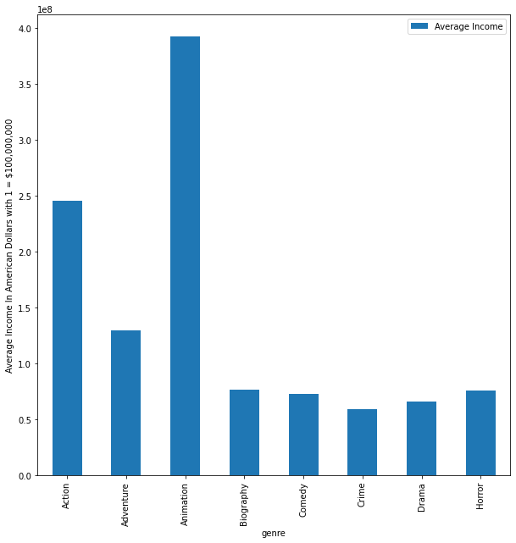
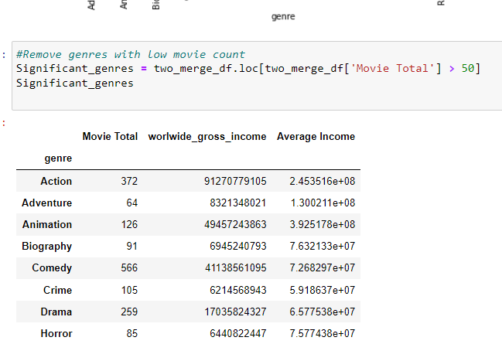
Analysis Genre all Years
Above we see the graph when we remove movies genres that have to few data points
Above we see the genres and what they make on average for all the years.

Slide 3
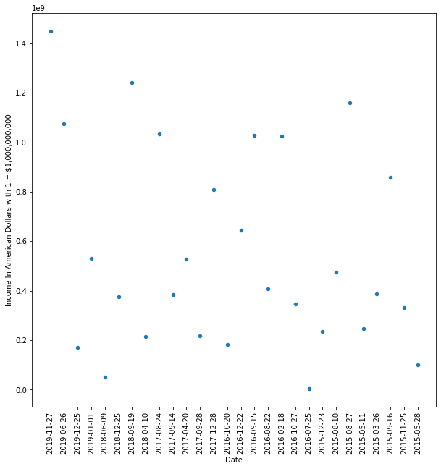
Analysis of the two Highest earning genre with significant Data.
Here we have the plot of the Income of the animation movies plotted against dates for the latest five years we have 2015-2020.
As we can see that animation movies income doesn’t trend up or down over the years so the genre is stable choice.
On the next page you can see the same is true for the action genre.

Slide 4
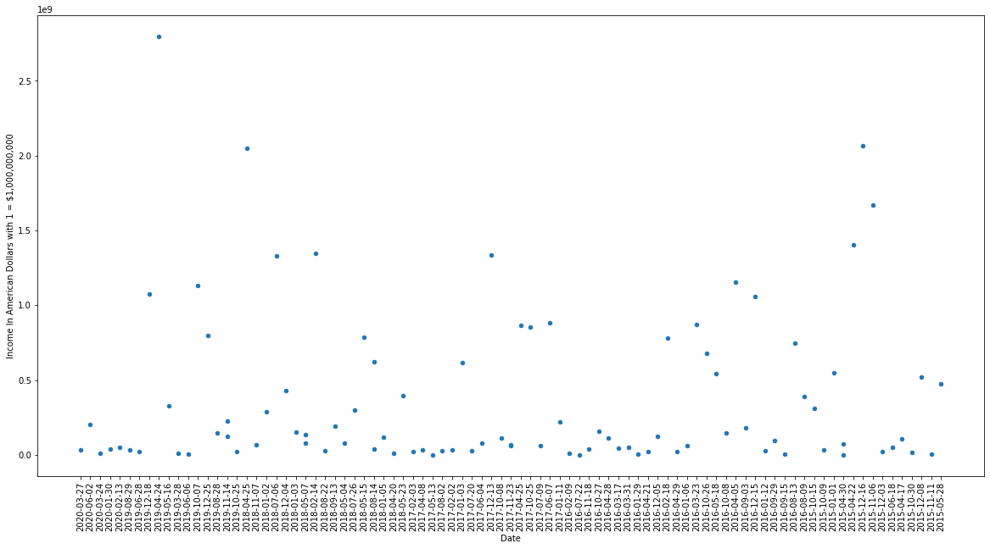

Slide 5
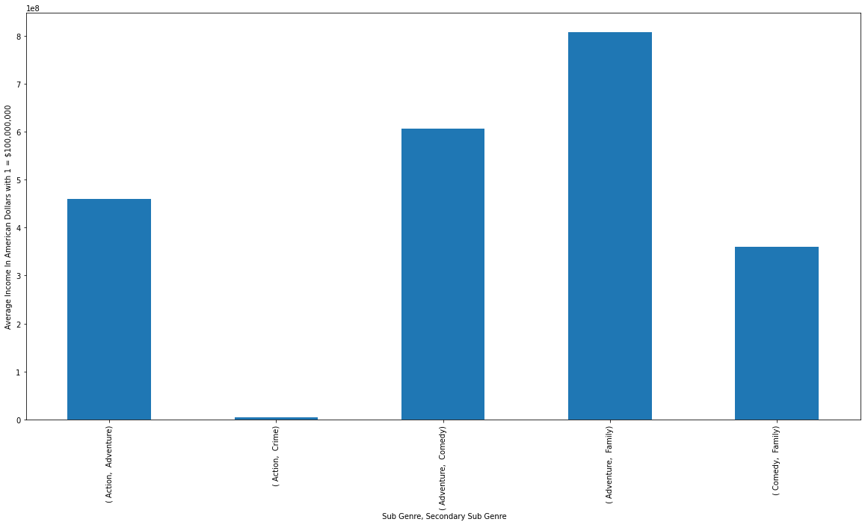
Animation Average Income of Sub genres during 2015-2020
In this we see which animation movies have the highest average income based on there sub genres.
We can see that Animation movies with the family and adventure sub categories do very.
While action crime animation movies do very poorly based the data we have.

Slide 6
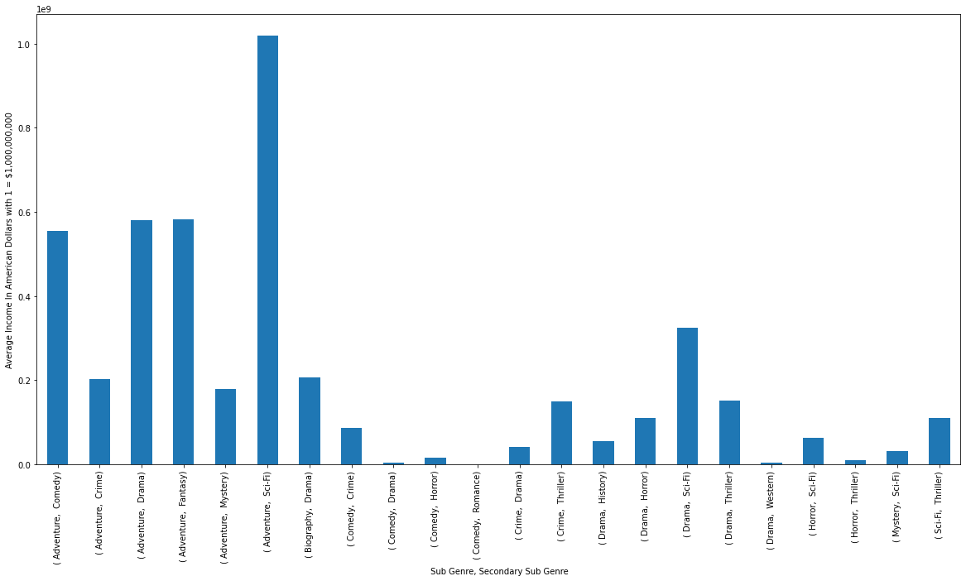
Action Movies and there sub genres Average income 2015-2020.
Here we see action movies with the sub genres and we see that action movies only really produce high incomes with certain sub genres for the last five years.
So the average income for Action genre is being held up by only several sub genre combinations and there are many you should steer away from.
The stand out combination to go for is action, adventure, sci-fi

Slide 7
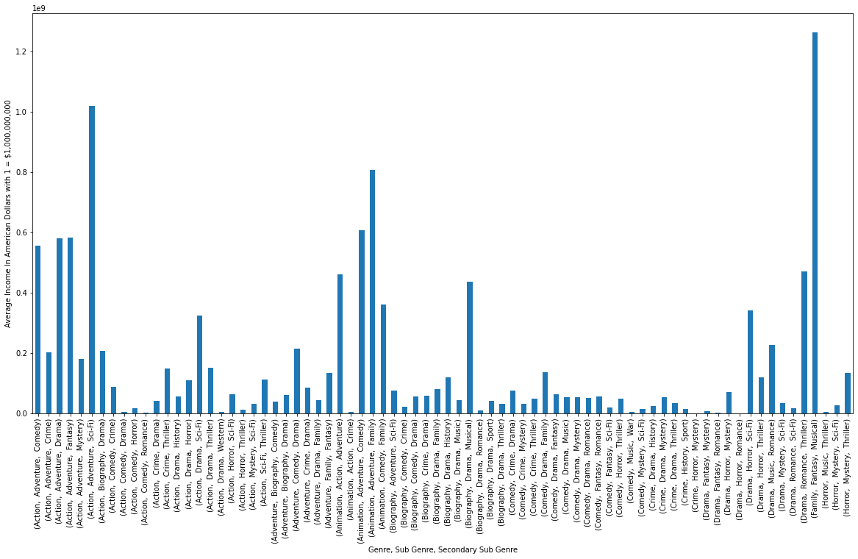
Analysis genre and sub-genre 2015-2020
I decided to analysis the last five years and see if any other genres had high average sub genre earners and where being held back by other underperforming sub genres.
You can see some drama and biography movies and similar averages to some of the top genres lower earning sub genres.

Slide 8
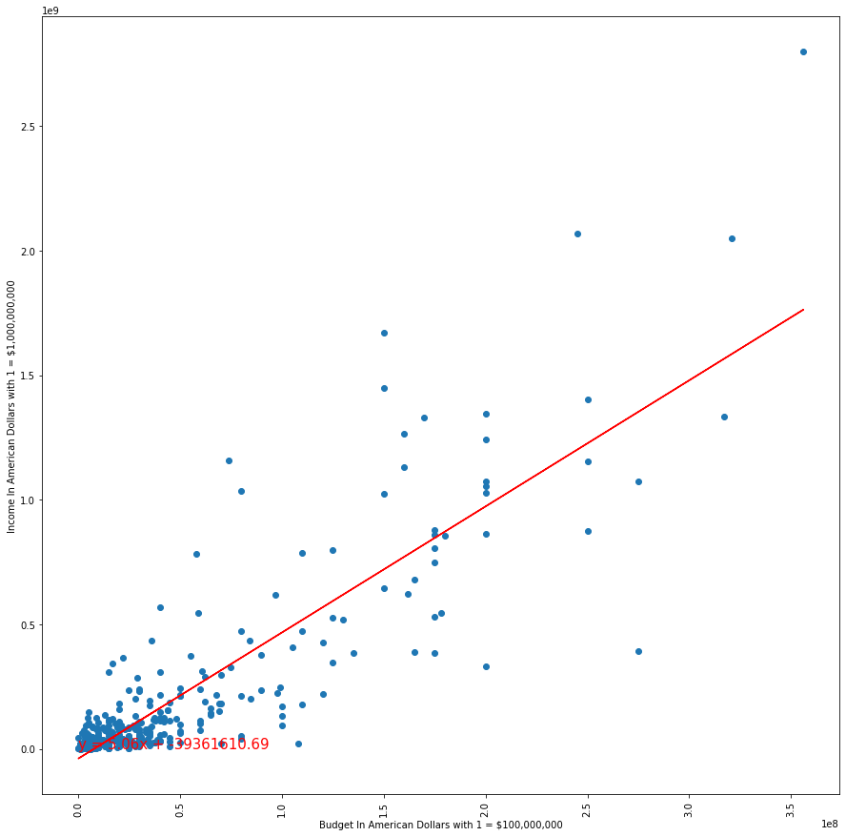
Budget vs Gross Income
Here I plotted Budget against the Gross Income to see the correlation.
As we can see there is definitely a correlation between higher budgets and higher gross income.
However once you get to the higher budgets this relation of income to budget becomes much less certain.
This means lower budget movies are more likely to make what you think they will but won’t make much above that unlike higher budget movies which are more risky but offer a greater reward.

Slide 9
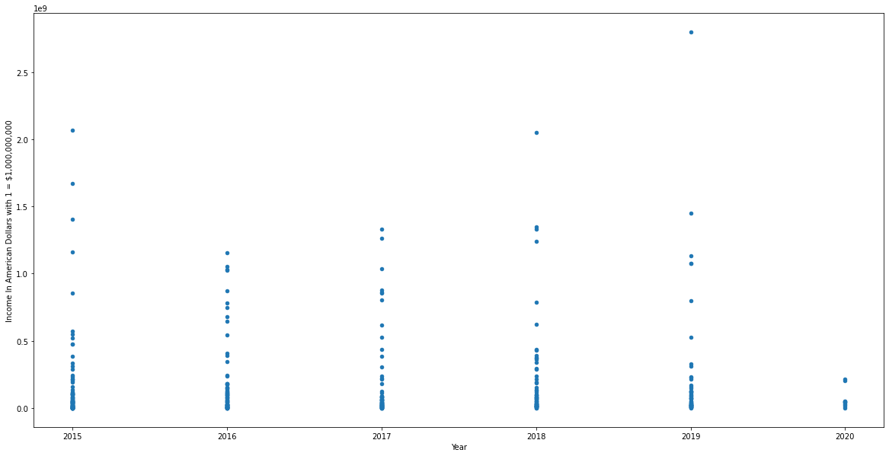
Gross income last five years
As we can see movie Gross incomes have remained stable during the latest years of 2015-2019
Though less movies to go by in the 2020 which is probably due to covid. So we can’t be entirely certian

